Slide 1
Science Case Update for a
UK X-ray Free Electron Laser (UK XFEL)
Commissioned by STFC on behalf of UKRI to be completed by May 2020 to support in consideration of “Mission Need” (CD0)
We are seeking to identify scientific opportunities for an X-ray FEL with capabilities at, and beyond, the current state-of-the-art
We need to consider the current science landscape, and the future opportunities that may emerge over the coming decades
We are seeking engagement with Academia, UK Government (AWE, Facilities, Research Councils, DSTL), Industry, Learned Societies & Research Charities etc.
You can find more project information at:
https://www.clf.stfc.ac.uk/Pages/UK-XFEL-Scientific-Case-Consultations.aspx
Jon Marangos, Imperial College j.marangos@imperial.ac.uk

Slide 2
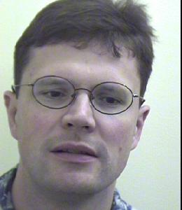
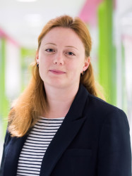
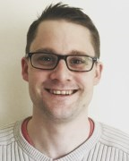
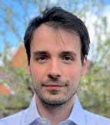
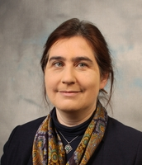
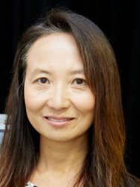
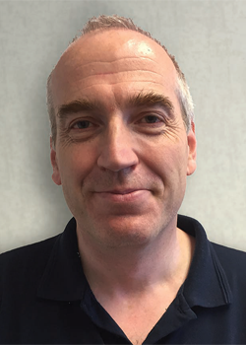
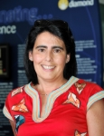
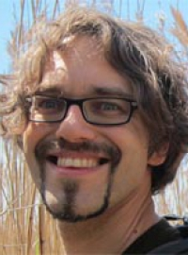

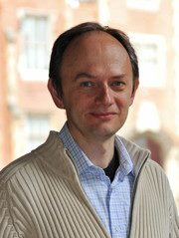
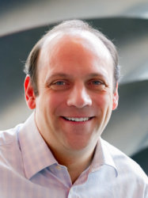

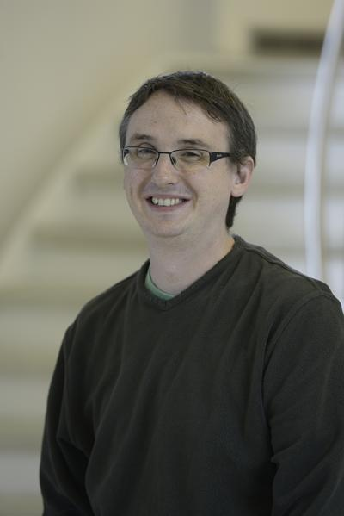
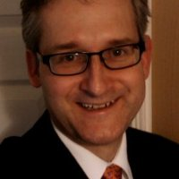

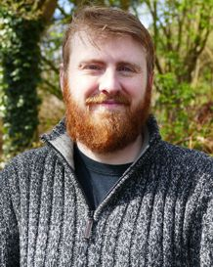
Science Team
Nano/Quantum materials: Ian Robinson (UCL/Brookhaven), Anna Regoutz (IC), Marcus Newton (Soton), Simon Wall (ICFO)
Materials/Applications : David Rugg (RR), Sven Schroeder (Leeds), David Dye (IC)
Matter in extreme conditions: Andy Higginbotham (York), Andy Comley (AWE), Sam Vinko (Ox), Marco Borghesi (QUB), Malcolm McMahon (Edinburgh), Justin Wark (Ox)
Life sciences: Allen Orville (DLS), Jasper van Thor (IC), Xiaodong Zhang (IC)
Chemical sciences: Julia Weinstein (Sheffield), Russell Minns (Soton), Sofia Diaz-Moreno (DLS), Tom Penfold (Newcastle)
Physical sciences: Adam Kirrander (Edinburgh), Amelle Zair (KCL), Jason Greenwood (QUB), Jon Marangos (IC)

Slide 3
Science Opportunities with XFELS
X-ray FELs give bright ultrafast pulses of X-rays that provide the capability for snap-shot imaging and time-resolved determination of atomic scale structure and electronic states in matter using X-ray scattering and X-ray spectroscopy
This is a unique, incisive, capability that opens a window into structure and dynamics with impact across a wide landscape of science and technology
This is being used alongside other powerful modalities (optical (UV-THz), neutron, cryo EM, UED, synchrotron X-ray, NMR etc.) to give us the best tools to probe and control matter

Slide 4
Science Opportunities with XFELs
Access to structural dynamics: Dynamical phenomena can be probed after laser excitation on a time scale down to femtoseconds thus covering electronic dynamics, lattice dynamics and chemical bonds breaking/forming.
Access to transient states: Matter can be probed under only transiently attainable conditions of extreme pressure, high E & B fields, high energy density and laser/THz dressing.
New modes of crystallography & nanoscopic imaging: For seeing the nanoscopic arrangements relevant to nanotechnology and life-sciences free from radiation damage and adverse effects of sample preparation.
Capturing rare events: In physical, chemical and biological systems critical processes can proceed through brief rare events (e.g. barrier crossings) arising from intrinsic fluctuations.

Slide 5
Primary science driver is access to timescales not accessible to other x-ray photon sources
Timescales uniquely accessible to XFELs
Timescales accessible to XFELs and other sources
Electron-ion coupling timescales in metals/ dense plasma
Primary photoexcitation event
Lattice dynamics, exciton dynamics, magnon dynamics etc.
Nuclear processes
Vibronic coupling timescales (chemical reaction)
Secondary/tertiary structure dynamics in biomolecules timescales
How best to measure these processes with high fidelity in-situ
is very much an area of active research
Valence electron dynamics
Ro-vibronic coupling timescales (structural fluctuation)
Inner shell electron dynamics
Timescales for modes excited at thermal equilibrium (T = 300 K)
Timescales for modes excited at thermal equilibrium (T = 6000 K)
10⁻¹⁷
10⁻¹⁶
10⁻¹⁵
10⁻¹⁴
10⁻¹³
10⁻¹²
10⁻¹¹
10⁻¹⁰
10⁻⁹
10⁻⁸
10⁻⁷
Time s
Laser plasma
Synchrotron
XFEL
(future)
(current)

Slide 6
We are developing project alignment to: Industrial Strategy & Grand Challenges
Ancipate a national XFEL providing substantial direct investment into UK economy via construction, procurement and jobs
Uplift of fraction of GDP for R&D from 1.65% to 2.4 % by 2027
Anticipate an XFEL boosting science, technology and know-how:
Advanced Materials
Energy and Sustainable Chemistry
New Therapies & Drugs
Training at all levels:
Research, Technology, IT & Apprenticeships

Slide 7
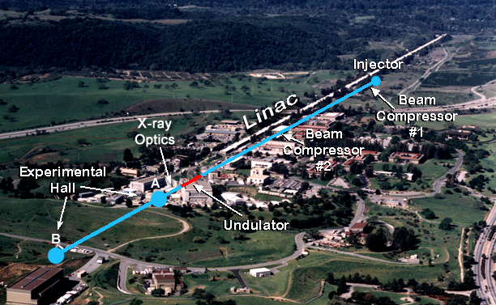
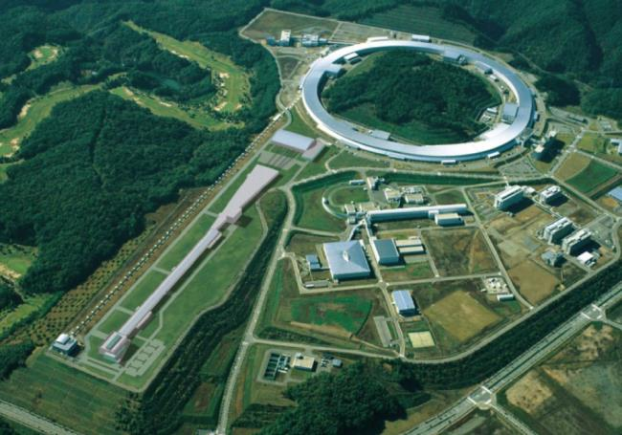
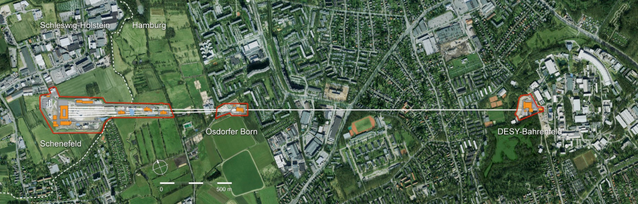
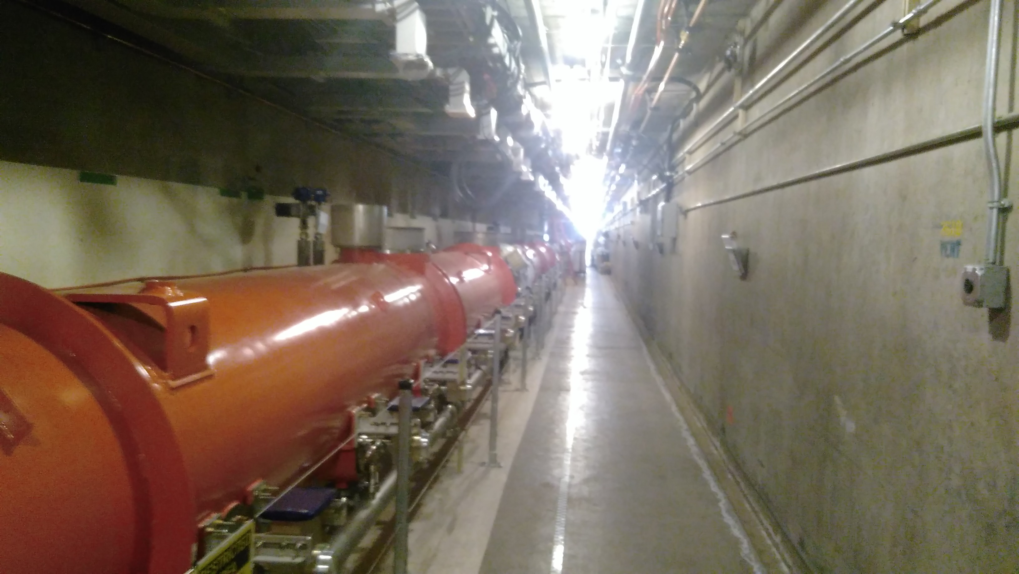
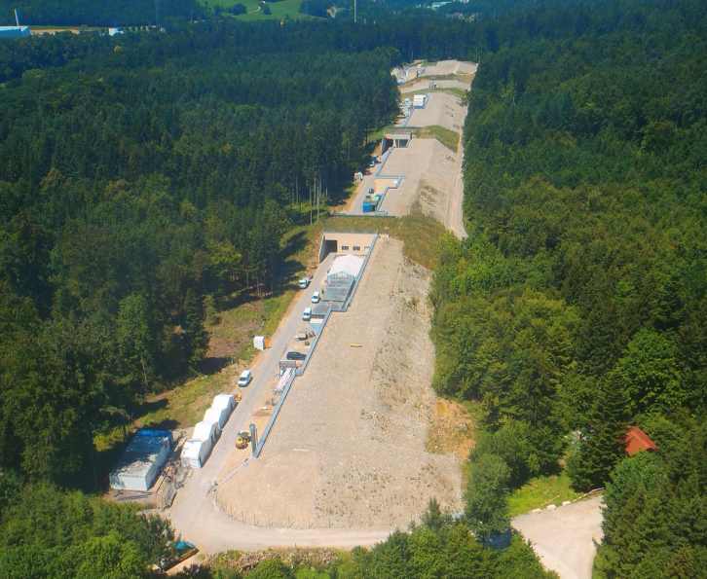
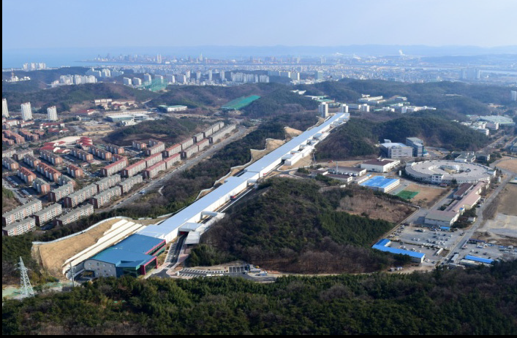
Existing X-ray FELs: Anticipate that these will satisfy scientific need for next 5 to 10 years
LCLS, USA – 2009
SACLA, Japan – 2011
Facility Summary
LCLS (USA)
LCLS II & LCLS II HE (USA)
SACLA (Japan)
European XFEL (Germany)
Flash I & II (Germany)
Fermi@Elettra (Italy)
Swiss FEL (Switzerland)
PAL XFEL (Korea)
Dalian Light Source (China)
Shanghai Light Source (China)
Large investments are being made, e.g. in USA via Basic Energy Sciences of DOE
European XFEL, Germany – 2016/17
LCLS II, USA – 2021
SwissFEL – 2016/17
PAL XFEL, Korea – 2016/17
SXFEL, Shanghai – 2018-25

Slide 8
UK XFEL is a long range science planning exercise
It would deliver science for the late 2020’s, 2030’s, 40’s & 50’s
It should be a cutting edge machine at first light or it could soon be obsolete
We need to take a wide view of where there will be science impact
We need to consider the full range of industrial impact in the UK
Need to see it as an important part of the international network of Light Source provision (not necessarily doing everything – but certainly doing some things better than anywhere else)

Slide 9
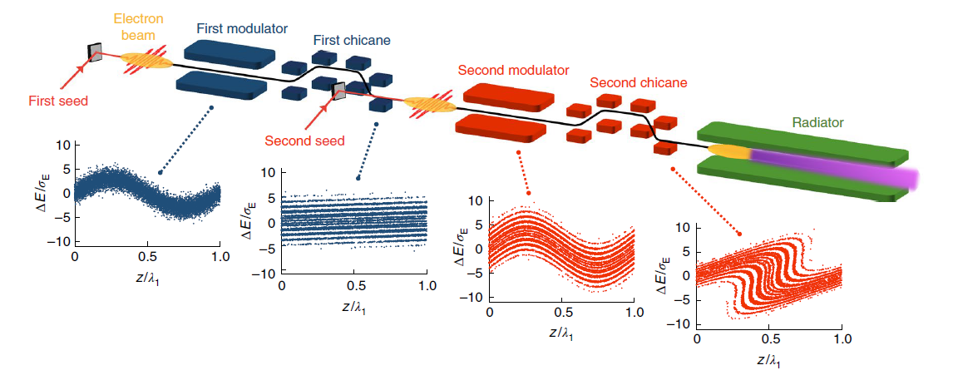
Anticipating further advances and future opportunities
The technology is not static – already in 10 years there have been remarkable improvements of performance and instrumentation
Now non-linear/multidimensional X-ray spectroscopy is in reach and first pioneering work on X-ray holography, quantum imaging, attosecond science etc. are underway
Methods beyond SASE are likely to become widely available (seeding - e.g. at FERMI, enhanced SASE - e.g. XLEAP, superradiance schemes, chirped schemes, XFELO and RAFEL under development etc..)
Echo enhanced seeding @ FERMI (2019)
XLEAP two-colour attosecond pulses @ LCLS (2019)

Slide 10
Options might include:
Build a unique UK XFEL optimised for new capability
Build a UK XFEL providing capacity well beyond 10 years
Invest more in dedicated UK facilities at existing XFELs
Increase investment to support users in exploiting existing opportunities (e.g. long term grant funding schemes, CDT’s, “UK XFEL Institute”)
Extend activities of existing Life and Physical Sciences Hubs
A combination of the above……

Slide 11
Next Steps
We start this exercise with an open mind as to the most exciting science that might be prioritised and the accompanying machine specification
We have opened a free format consultation with the UK science and technology community to gather information and ideas
https://www.clf.stfc.ac.uk/Pages/UK-XFEL-science-case.aspx
A science case will be drafted through early 2020 with possibilities for continued input from the UK community
Oct 2nd Matter at Extreme Conditions (Edinburgh)
Nov 5th Life Sciences (Crick)
Nov 13th Frontiers in Physical Sciences (Imperial)
Nov 27th Quantum Materials & Nanotechnology (Southampton)
Dec 4th X-ray FEL Applications (Warwick)
Dec 11th Chemical Dynamics & Energy (Newcastle)

